Slide 1

OS Lab - Shell Scripting

Slide 2
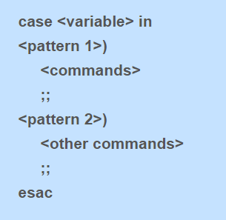
Case Statement

Slide 3
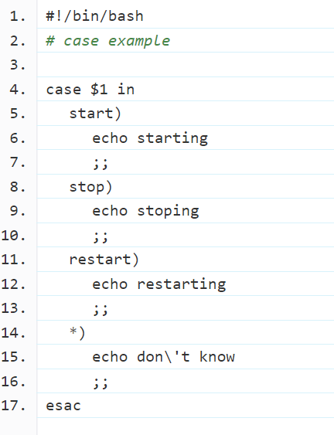
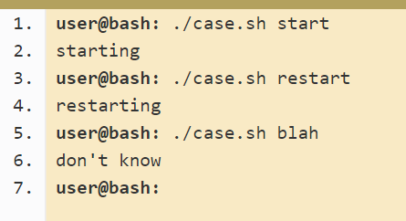
Example

Slide 4
LOOPS

Slide 5
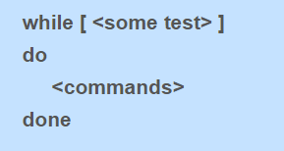
While Loop
While (stmt)
{//start
//////
}//end

Slide 6
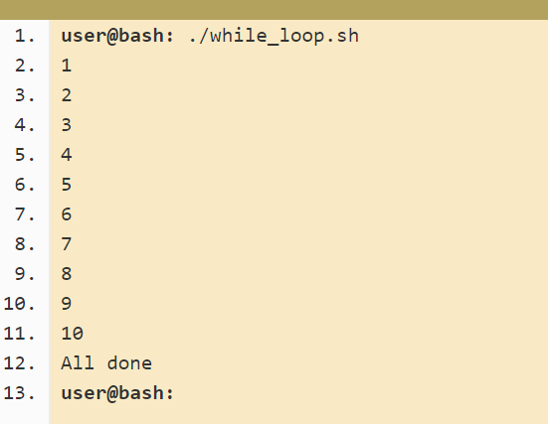
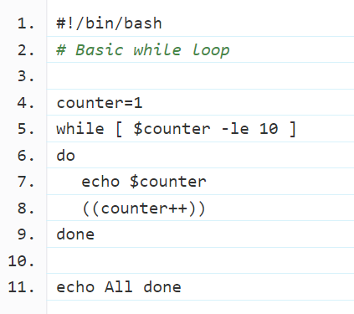
Example

Slide 7
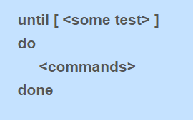
Until Loop

Slide 8
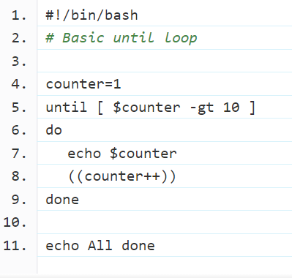
Example

Slide 9
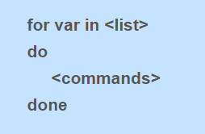
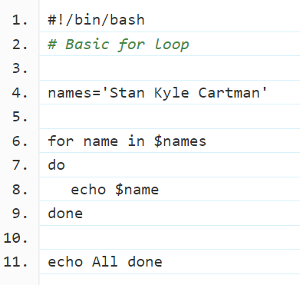
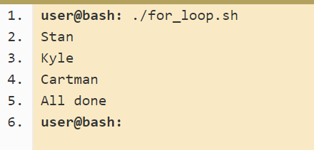
For Loop
for (int i=0; i<10;i++)
{//start
//////
}//end

Slide 10
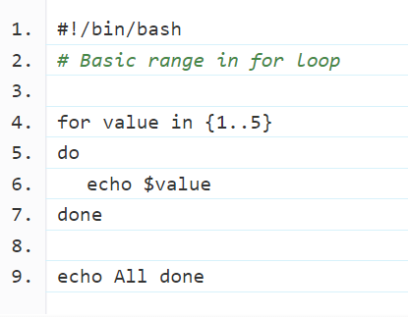
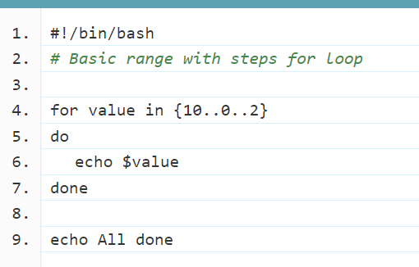
Ranges in for loop

Slide 11
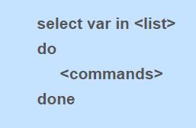
Select Statement

Slide 12
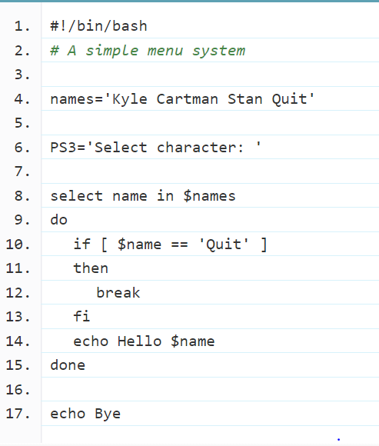
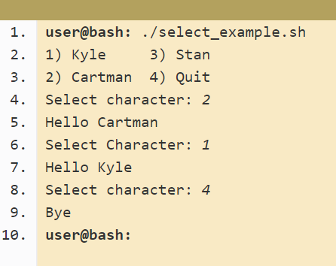
Example

Slide 13
Functions

Slide 14
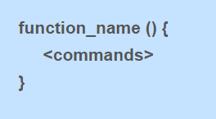
Simple function syntax
In other programming languages it is common to have arguments passed to the function listed inside the brackets (). In Bash they are there only for decoration and you never put anything inside them.
The function definition ( the actual function itself) must appear in the script before any calls to the function.

Slide 15
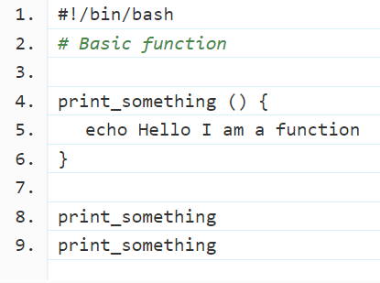
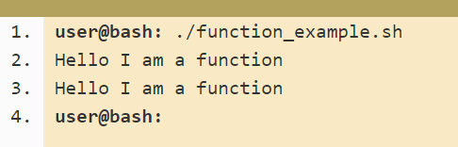
Example

Slide 16
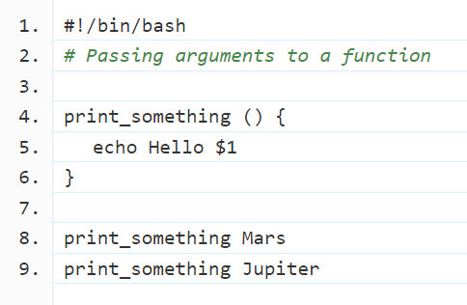
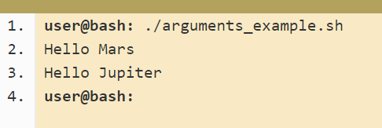
Passing Arguments

Slide 17
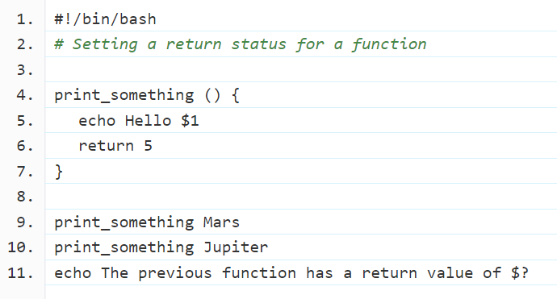
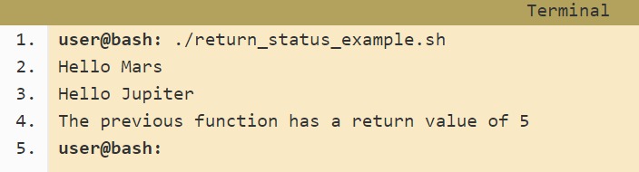
Returning Value

Slide 18
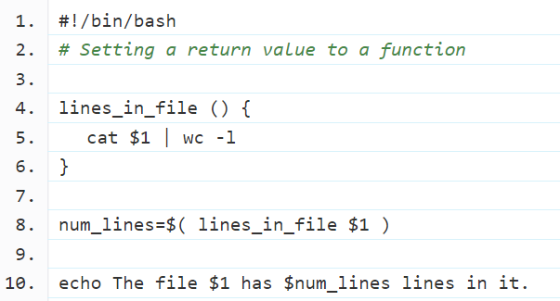
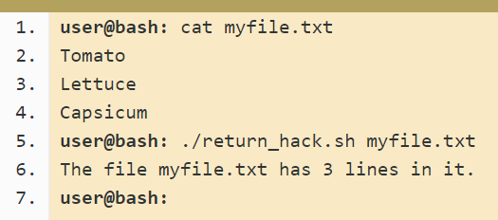
Returning Value (Alternate way)

Slide 19
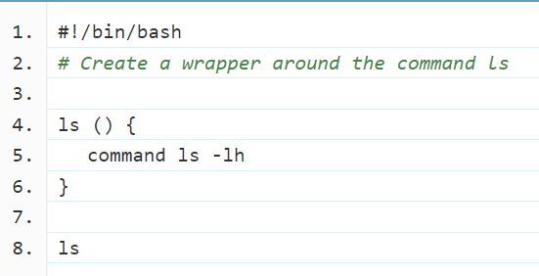
Overriding commands

Slide 20
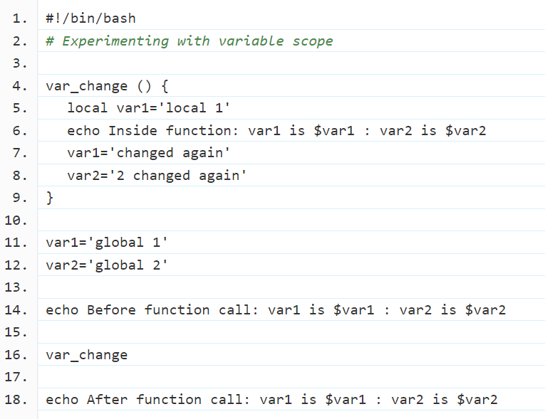

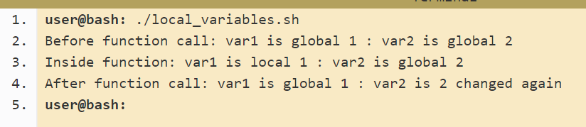
Variable scope

Slide 21
Example output

Slide 22
Built-in Functions
Built-in functions
Built- in functions are the function already defined in a programming language
the program does not require defining it
they directly use it with in their code
Some built-in functions are also defined in shell scripting e.g. random function etc.
Example:
num_rows=4
for ((i=1;i<=num_rows;i++))
do
echo $RANDOM
done

Slide 23
Built-in Functions
Built-in functions
Shift - shift [n] (Shift the positional parameters to the left by n)
Test- test expr ( evaluate a conditional expression and return status of 0/1)

Slide 24
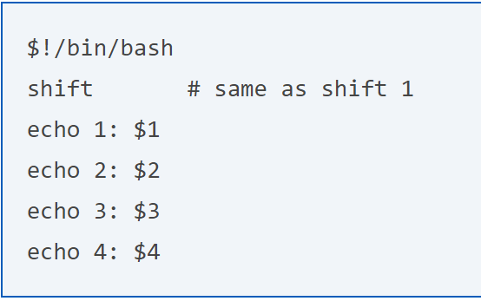
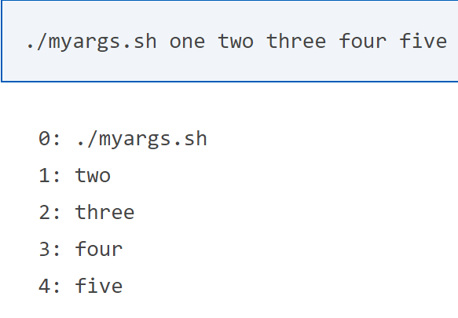

Slide 25
Recursive functions
A recursive function is a function that calls itself during its execution.
This enables the function to repeat itself several times
outputting the result at the end of each iteration

Slide 26
Recursive functions
You can write a recursive function in shell script
Example
array=(1 2 3 4)
f() {
if [ "$1 == -1 ]
then
return
else
a=$1
echo $((array[$a])) //2,1,
f $((a-1)) #recursive function call
fi }
f 1 #function call with parameter

